Slide 1
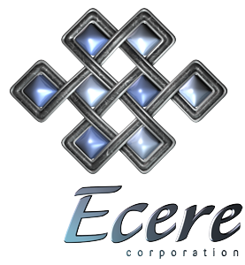
Building a simple board game with the Ecere SDK
An introduction to drawing graphics and processing mouse input with Ecere

Slide 2
Rules of the Game
Consists of a 4 x 4 grid and 2 colors of stones.
Similarly to tic-tac-toe, you must line up 4 of your stones to win in any direction (horizontal, vertical or diagonal).
There are one of 8 different paired symbols on each square.
Each time you just completed a pair, you must take out a stone of your opponent.
For the first turn, a single stone is played. For the remaining turns, two stones are played.

Slide 3
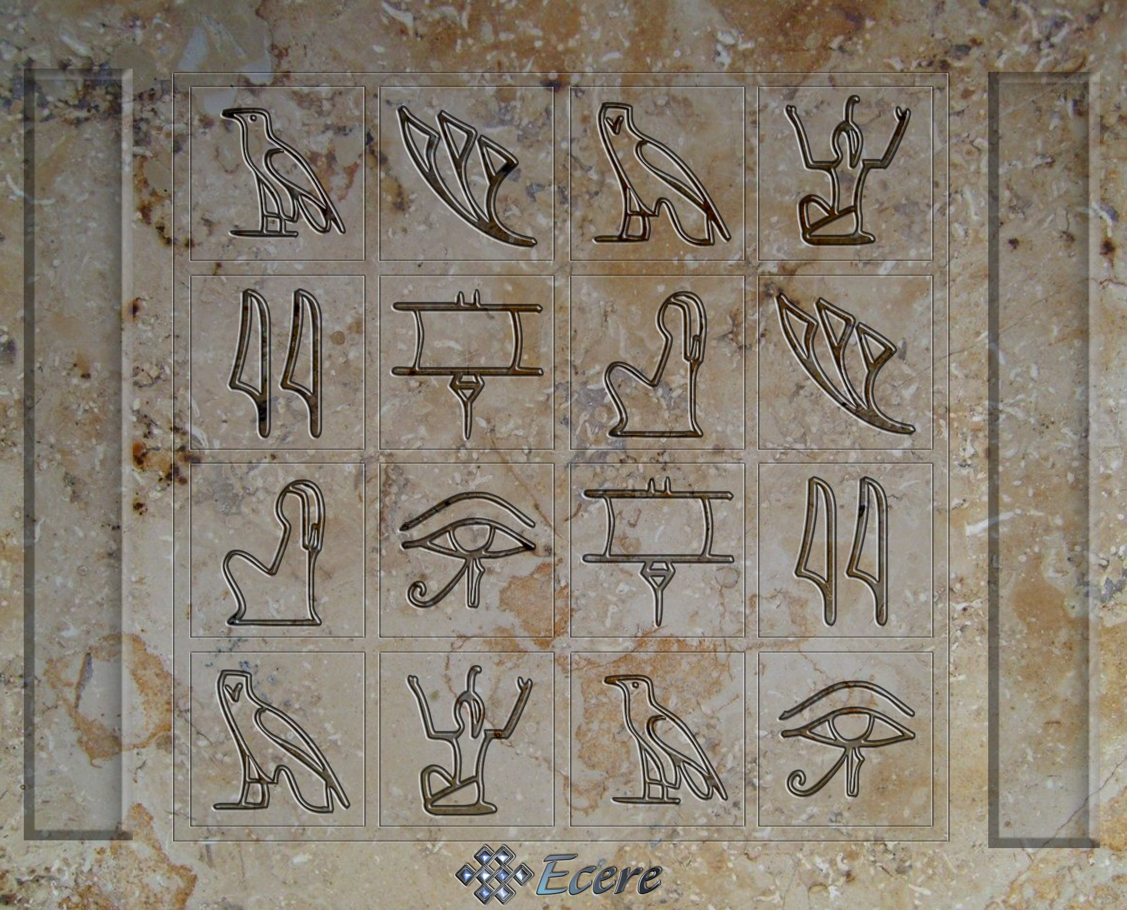
The board

Slide 4
Ecere Classes we’ll use
Window
Menu / MenuItem / MenuDivider
Surface
BitmapResource / Bitmap

Slide 5
Setting up our main window
import "ecere"
class MainWindow : Window
{
text = "BrainStonz";
background = black;
borderStyle = sizable;
hasMaximize = true;
hasMinimize = true;
hasClose = true;
state = maximized;
size = { w = parent.clientSize.h * 2038/1647,
h = parent.clientSize.h };
}
MainWindow mainWindow {};

Slide 6
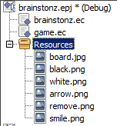
Using Bitmaps
Ecere supports adding resources to executables:
Automatic bitmap loading through the BitmapResource class:
BitmapResource boardBmp { ":board.jpg", window = this };

Slide 7
Resizable Graphics
We’ll assume a screen wider than tall
Our board bitmap is 2038 x 1647 pixels
We’ll always map the height of the board to the height of our client area (the inside of our MainWindow)
We’ll scale the width of the board, as well as the rest of the graphics accordingly:
define scale = (float)clientSize.h /
boardBmp.bitmap.height;

Slide 8
DrawBitmap
We’ll create a utility method to help us draw all graphics in this resizable manner:
void DrawBitmap(Surface surface,
BitmapResource res, int x, int y, float s)
s is an extra scale which we will use to render some bitmaps bigger (pass 1 for default size)
We’ll call it as such to draw the board:
DrawBitmap(surface, boardBmp, 0,0, 1);

Slide 9
The Surface
The Surface is used to draw graphics.
The GUI system provides a Surface when you override the OnRedraw method of a Window
Surface::Blit is used to draw bitmaps with a 1:1 pixel ratio for source and destination
Surface::Stretch is used to draw bitmaps with a different pixel ratio
Surface::Filter is a bilinear filtering version of Surface::Stretch

Slide 10
DrawBitmap (code)
void DrawBitmap(Surface surface, BitmapResource res, int x,
int y, float s)
{
Bitmap board = boardBmp.bitmap;
Bitmap bmp = res.bitmap;
int bw = (int)(board.width * scale;
int bh = clientSize.h;
int bx = (clientSize.w - bw) / 2;
int by = (clientSize.h - bh) / 2;
surface.Filter(res.bitmap,
bx + (int)(x * scale), by + (int)(y * scale), 0,0,
(int)(s*bmp.width * scale), (int)(s*bmp.height * scale),
bmp.width, bmp.height);
}

Slide 11
OnRedraw
Let’s add an OnRedraw to our Window:
void OnRedraw(Surface surface)
{
// Draw the board
DrawBitmap(surface, boardBmp, 0,0, 1);
}

Slide 12
The Board Layout
whiteDrawer
blackDrawer
upperLeft
define upperLeftX = 334;
define upperLeftY = 147;
define spaceX = (676 - upperLeftX);
define spaceY = (485 - upperLeftY);
define whiteDrawer = 145;
define blackDrawer = 1885;
define topDrawer = 126;
space

Slide 13
Mouse Input
Let’s handle left mouse click events
To figure out which square of the board they fall into, we’ll have to reverse our graphics resizing mapping!
bool OnLeftButtonDown(int x, int y, Modifiers mods)
{
int w = (int)(boardBmp.bitmap.width * scale);
int bx = (clientSize.w - w) / 2;
int by = (clientSize.h - clientSize.h) / 2;
x = (int)((x - bx) / scale);
y = (int)((y - by) / scale);
if(x > upperLeftX && y > upperLeftY)
{
int sx = (x - upperLeftX) / spaceX;
int sy = (y - upperLeftY) / spaceY;
if(sx < 4 && sy < 4)
{
}
}
return true;
}

